Slide 1
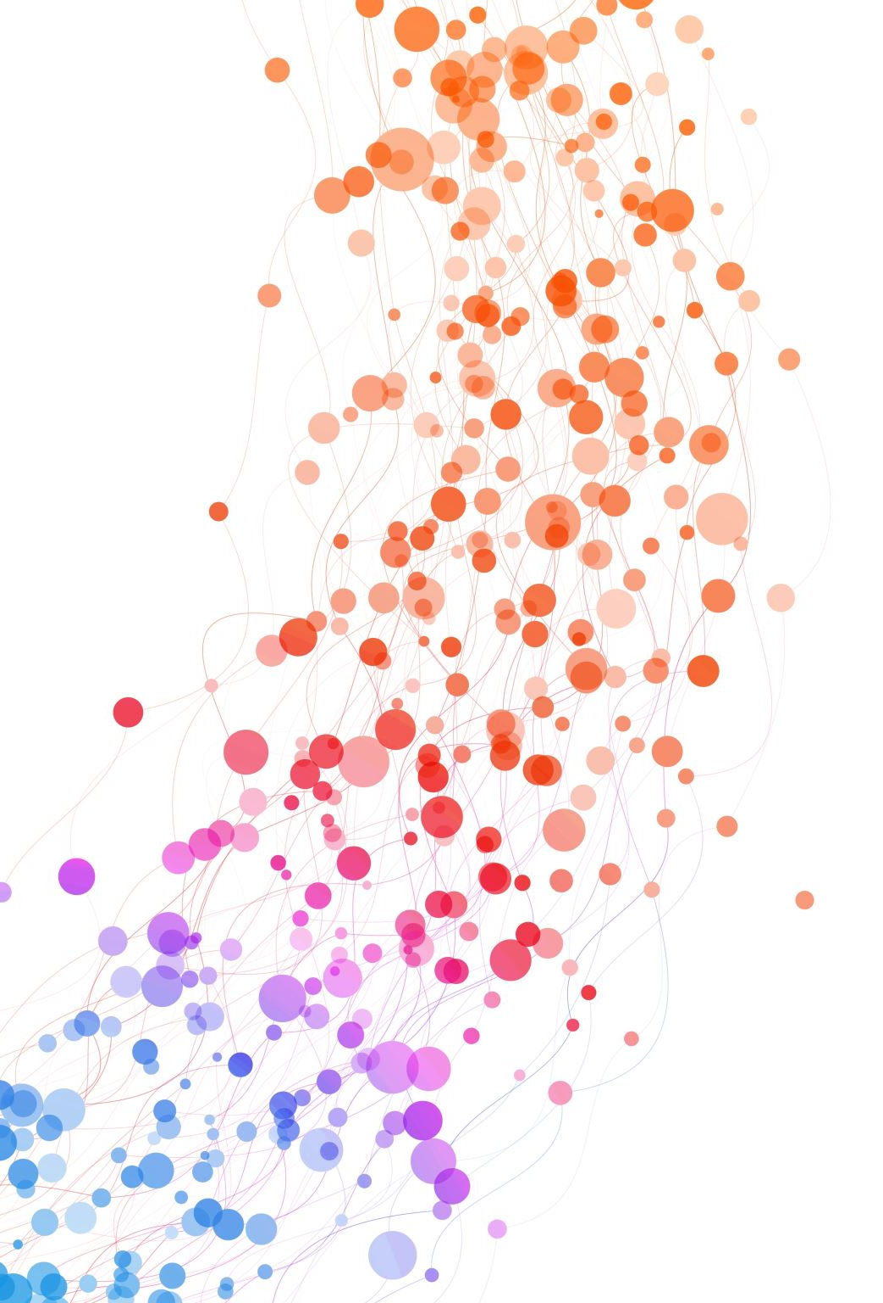
Dynamic Matching of Users and Creators on Social Media Platforms
Dan Huttenlocher, Hannah Li, Liang “Charles” Lyu, Asu Ozdaglar, James Siderious
MIT

Slide 2




Social Media and Recommendations

Slide 3


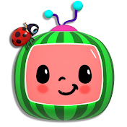
Social Media and Recommendations

Slide 4
Social Media and Recommendations
Platform
Recommendations

Slide 5
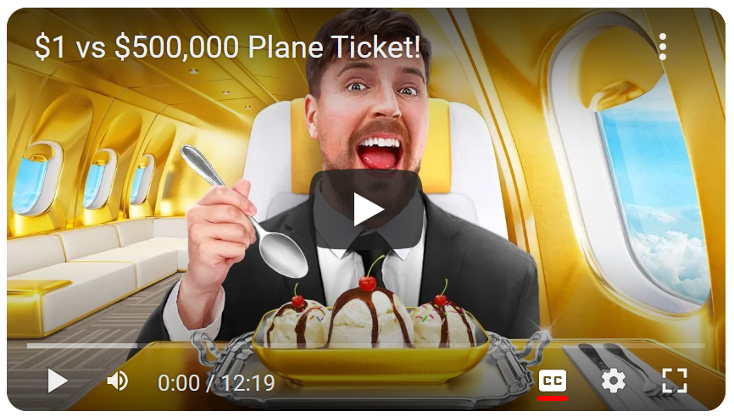
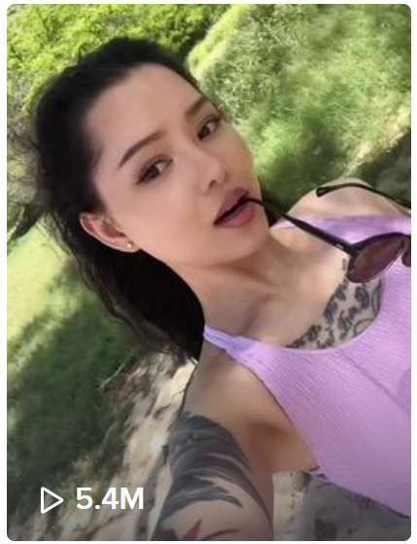
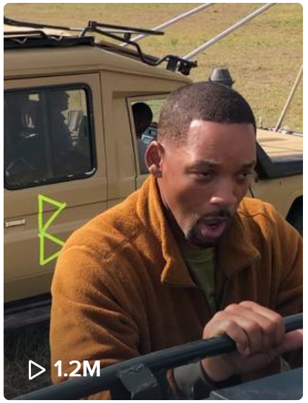
Current Recommendations Literature…
BEST
BEST
?
BEST
Focuses on
user preferences

Slide 6
Current Recommendations Literature…
BEST
BEST
!
BEST
Focuses on
user preferences
Neglects
creator incentives

Slide 7
Current Recommendations Literature…
Need incentives from BOTH sides!
Stay or leave?
How much to consume?
What to consume?
Stay or leave?
How much to produce?
What to produce?
BEST
BEST
BEST
Focuses on
user preferences
Neglects
creator incentives

Slide 8

Dynamics of Content Matching
2 views
3 views
2 views
1 view
Creator leaves
(Small audience)

Slide 9
Cascade of Departures
…
Unsatisfied with this recommendation
Creator leaves
(Small audience)
User leaves
(Bad recommendations)
Creator leaves
(Small audience)

Slide 10
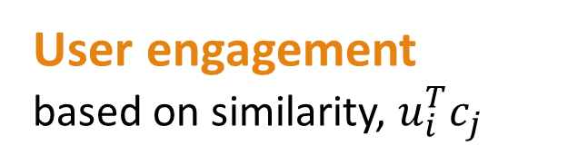
Our Model
(0.9, 0.1)
(1, 0)
(0.8, 0.3)
(0.8, 0.3)
Type vectors
(fixed, known to platform)
(0.7, 0.7)
(0.7, 0.7)
(0.1, 0.9)
(0, 1)
User engagement
based on similarity, $u_{i}^{T}c_{j}$

Slide 11



Our Model
…
$$t=0$$
$$t=1$$
$$t=2$$
Sequential recommendations

Slide 12
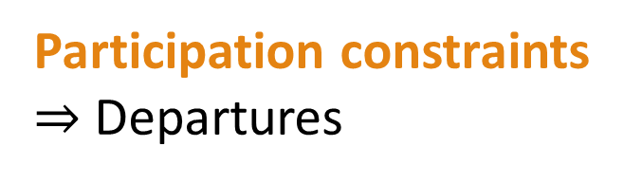
Our Model
…
Participation constraints
$⇒$ Departures
Need enough users
Need enough engagement

Slide 13

Our Model
…
…
Goal: Maximize
long-term total engagement
$$t=0$$
$$t=∞$$

Slide 14
Benchmarks
Immediate Engagement (IE)
#1
#2
…
#K
Maximizes immediate user engagement
Ignores creator constraints

Slide 15
Benchmarks
Immediate Engagement (IE)
Forward-Looking (FL)
#1
#2
…
#K
Maximizes immediate user engagement
Ignores creator constraints
Maximizes long-term user engagement

Slide 16

Benchmarks
Immediate Engagement (IE)
Forward-Looking (FL)
#1
#2
…
#K
Thm.
Thm.
$$\min{\frac{IE}{FL}}=0$$
FL is NP-Hard
Can do badly in long term
Reduction from Max Independent Set

Slide 17
Benchmarks
Our approach:
Audience Maximization (AM) algorithm
Focus on creator constraints
Prioritize creators that are hardest to satisfy
Immediate Engagement (IE)
Forward-Looking (FL)
#1
#2
…
#K
Thm.
Thm.
$$\min{\frac{IE}{FL}}=0$$
FL is NP-Hard
Can do badly in long term
Reduction from Max Independent Set

Slide 18

Simulations: AM vs. IE
$$𝔼\left[\frac{ALG}{FL}\right]$$
(approx. ratio)
Audience Maximization (AM) v2
AM v2
AM v2
Audience Maximization (AM) v1
AM v1
AM v1
Immediate Engagement (IE)
IE
IE
# users
Instance size
# creators
Increasing # users and creator constraints
Increasing size of entire instance
Increasing # creators only

Slide 19
More…
Clustering Algorithm
Constant factor approximation under density assumptions (fixing dimensionality)
Comparative statics of different algorithms
Come to our poster for more!

Slide 20
Thank you!

